Slide 1
Introduction to Content Management Systems
Day 4

Slide 2

What is Joomla
Joomla is an open source Content Management System, which is used to build websites and online applications. It is free and extendable which is separated into front-end and back-end templates (administrator). Joomla is developed using PHP, Object Oriented Programming, software design patterns and MySQL (used for storing the data).
Joomla is based on Mambo CMS which was developed by an Australian company in 2001 and initially released on August 17, 2005. The official version of Joomla 1.0 was released on September 22, 2005.

Slide 3
Core Features of Joomla
User Manager − It allows managing the user information such as permission to edit, access, publish, create or delete the user, change the password and languages. The main part of the user manager is Authentication.
Content Manager − It allows managing the content using WYSIWYG editor to create or edit the content in a very simple way.
Banner Manager − It is used to add or edit the banners on the website.
Template Manager − It manages the designs that are used on the website. The templates can be implemented without changing the content structure within a few seconds.
Media Manager − It is the tool for managing the media files and folder in which you can easily upload, organize and manage your media files into your article editor tool.
Contact Manager − It allows to add contacts, managing the contact information of the particular users.
Web Link Manager − The link resource is provided for user of the site and can be sorted into categories.
Search − It allows users to search the appropriate information on the site. You can use smart indexing, advanced search options, auto suggest searches to make Joomla search best.
Menu Manager − It allows to create menus and menu items and can be managed subsequently. You can put menu in any style and in multiple places.
RSS − It stands for Really Simple syndication which helps your site contents and RSS files to be automatically updated.

Slide 4
The Advantages of Joomla
It is an open source platform and available for free.
Joomla is designed to be easy to install and set up even if you're not an advanced user.
Since Joomla is so easy to use, as a web designer or developer, you can quickly build sites for your clients. With minimal instructions to the clients, clients can easily manage their sites on their own.
It is very easy to edit the content as it uses WYSIWYG editor (What You See Is What You Get is a user interface that allows the user to directly manipulate the layout of the document without having a layout command).
It ensures the safety of data content and doesn't allow anyone to edit the data.
By default, Joomla is compatible with all browsers.
The templates are very flexible to use.
Media files can be uploaded easily in the article editor tool.
Provides easy menu creation tool.

Slide 5
The Advantages and Disadvantages of Joomla
It is a free, open source platform.
Joomla is designed to be easy to install and set up even if you're not an advanced user.
Since Joomla is so easy to use, you can quickly build sites for your clients. With minimal instructions to the clients, clients can easily manage their sites on their own.
It is very easy to edit the content as it uses WYSIWYG editor (What You See Is What You Get is a user interface that allows the user to directly manipulate the layout of the document without having a layout command).
It ensures the safety of data content and doesn't allow anyone to edit the data.
Joomla is compatible with all browsers.
The templates are very flexible to use.
Media files can be uploaded easily in the article editor tool.
Provides easy menu creation tool.
There may be compatibility problem while installing several modules, extensions and plugins simultaneously.
Not all plugins and modules are free.
Development is difficult to handle when you want to change the layout.
It makes website heavy to load and run.
Advantages
Disadvantages

Slide 6
Real World Joomla Examples
Corporate web sites or portals
Corporate intranets and extranets
Online magazines, newspapers, and publications
E-commerce and online reservations
Government applications
Small business web sites
Non-profit and organizational web sites
Community-based portals
School and religious web sites
Personal or family homepages
For details go to https://showcase.joomla.org

Slide 7
Joomla System Requirements
Database − MySQL 5.1 + (or MS SQL Server/Azure)
Web Server −
Apache
WAMP (Windows)
LAMP (Linux)
XAMP (Multi-platform)
MAMP (Macintosh)
Nginx
Microsoft IIS
Operating System − Cross-platform
Browser Support − IE (Internet Explorer 7), Firefox, Google chrome
SSL (Secure Socket Layer) − A valid security certificate is required for HTTPS
PHP Compatibility − PHP 5.4+ or PHP 5.3.10+

Slide 8
Joomla Download and Prerequisites
Download the latest version fo Joomla from http://www.joomla.org/download.html
Create Database
Create a new empty database and user/password for Joomla.
Setup Wizard
Extract the downloaded Joomla folder into your web server or localhost web root or a directory under it.
Open your browser and navigate to your Joomla file path, then you will get the first screen of the Joomla installer as shown in the following screen. In our case the path is localhost/< Your_joomla_folder >.

Slide 9
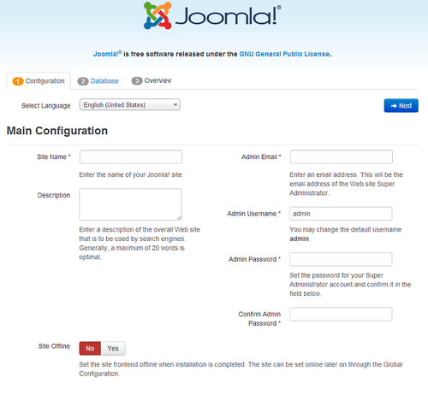
Step 1: Joomla Site Configuration
Site Name: the name of your website
Description: enter a description of the website. This is a the global fallback meta description used on every page which will be used by search engines.
Admin Email Address: the admin email address. Enter a valid email in case you forget your password. This is the email address where you'll receive a link to change the admin password.
Admin Username: Joomla! uses a default "admin" as the username for the Super User. You can leave it as is, change it or use My Profile in the Administration interface to change it later.
Admin Password: remember that super user has maximum control of the site (frontend & backend), so try to use a difficult password. Use My Profile in the Administration interface to change it later.
Site Offline: click the Yes or No box. Yes - this means when installation is complete, your Joomla! website will display the 'Site is offline' message when you browse to yoursitename.com to view the home page. No - this means the site is live when you browse to yoursitename.com to view the home page. You can use the Site Global Configuration in the Administration interface to change the Offline status at any time.

Slide 10
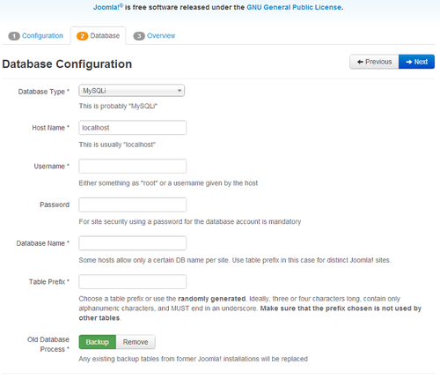
Step 2: Joomla Database Configuration
Database Type: MySQLi is the most common database type used with Joomla
Hostname Where is your database located? Common is localhost
Username: the username used to connect to the database
Password: the password for the database's username
Database Name: the name of the database
Table Prefix: one is generated automatically, but you can change it. For example, jos3_ can be used. Just don't forget to put the underscore character (_) at the end of the prefix.
Old Database Process: should the installer backup or delete existing tables during the installation of new tables? Click, Yes or No to select the choice.

Slide 11
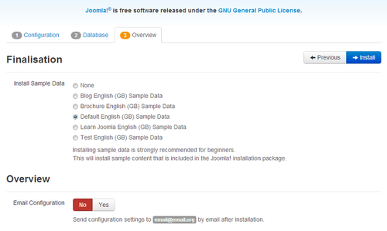
Step 3: Joomla Installation Review
The first options are for automatically installing sample content to the website and emailing the configuration settings.
If you are new to Joomla! it would be beneficial to install some sample data to see how Joomla! works. You can at this time choose to have the configuration settings emailed to you. If the Email Configuration choice is selected, the Email Password choice will appear. The email password is off by default for security. You can choose to have the password included, just click Yes.
Check the configurations of your install and the environment of the installation, and click “Install”.

Slide 12
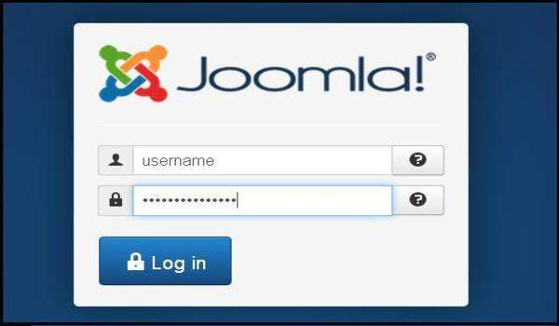
Joomla Admin Panel
After installing Joomla you should be able to login to your Joomla Admin Panel:
To access Joomla administrative panel, open the browser and type the URL as http://localhost/ <Your_joomla_folder>/administrator/index.php
Enter the username and password which you had mentioned during installation as shown in the step 3 of Set Up Wizard section and click on the login button.
You should also be able to preview your Joomla web site by opening the http://localhost/ <Your_joomla_folder> URL

Slide 13
Joomla Architecture
The architecture of Joomla contains following layers:
Database − Database is a collection of data and can be stored, manipulated and organized in a particular manner. The database stores the user information, content and many more required data of the site. It is used to store the administrative information to manage the Joomla site. Using Joomla database layer, it ensures maximum flexibility and compatibility for extension.
Joomla Framework − Framework is a collection of open source software, where the Joomla CMS is built. It is developed for more flexibility and breaks the framework into single modular packages which helps each package to develop more easily.
Components − Components are considered as mini applications. It consists of two parts i.e. Administrator and Site. Whenever a page gets loaded, component is been called to render the body of main page. The Administrator part manages different aspects of the component and the site part helps in rendering the pages when request is made by site visitor. Components are main functional unit of Joomla.
Modules − Modules is an extension which is used to render the pages in Joomla. It is also used to display the new data from the component. It frequently looks like boxes such as login module. In Joomla administrator the modules are managed by the module manager. It displays the new content and images when module is linked to Joomla components.
Plugin − This is also a kind of Joomla extension, it is very flexible and powerful for extending the framework. It contains a bit of codes that is used to execute the particular event trigger. It is commonly used to format the output of a component or module when a page is built. The plugin function which are associated with event are executed in a sequence when a particular event occurs.
Templates − Template determines the look of the Joomla website. There are two types of templates used i.e. Front-end and Back-end. The Back-end template is used to control the functions by the administrator where-as the Front-end template is a way to present the website to users. Templates are easy to build or customize your site. It provides maximum flexibility to style your site.
Web Browser − It is a server where the user interacts. It delivers the web pages to the client. The HTTP (Hyper Text Transfer Protocol) is used to communicate between the client and the server.

Slide 14
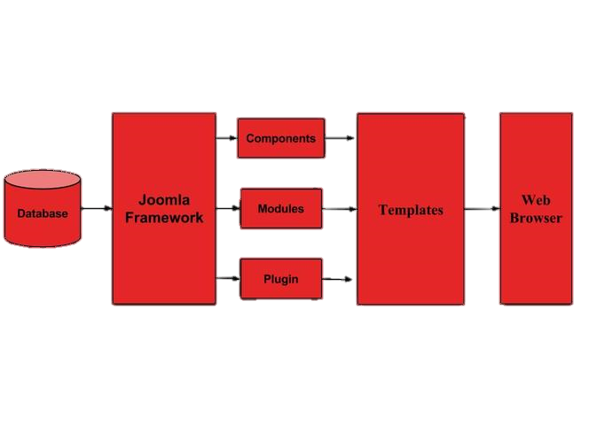
Joomla Architecture

Slide 15
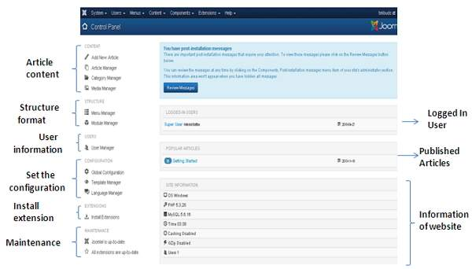
Joomla Control Panel
The Control Panel provides default features and functions of Joomla to access through clickable icons, menu bar etc. When you login to the Joomla administrative panel, you will get the screen as shown below.

Slide 16
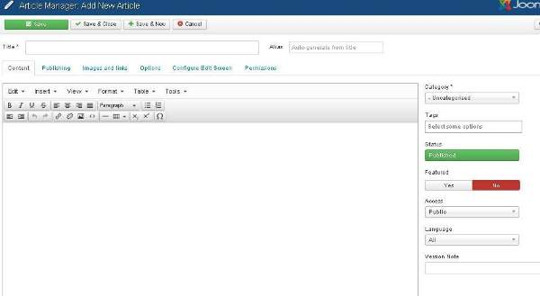
Joomla Article and Category Manager
In Article Manager, you can create the standard pages that consist of images, text and hyperlinks.
Click on Content → Article Manager → Add New Article menu on the Joomla administrative panel
Category Manager (Content → Category Manager) is used to create categories for the articles which allows grouping your content better.

Slide 17
Joomla Menus
Menu manager allows creating custom menus for your website and allows navigation through your website.
To add a new menu to your website, go to Menus → Menu Manager → Add New Menu
Menu Details:
Menu Item Type − It specifies the type of menu item such as articles, tags, web links, system links, contacts etc.
Link − It determines the link in the menu.
Target Window − It provides three options− Parent, New Window with Navigation and New without Navigation which targets the browser window when a menu item is clicked.
Template Style − You can select a template style for your website by clicking dropdown menu which gives Beez3 - Default and protostar - Default styles or provides default templates for your website.
Menu Location − It specifies which menu link will appear; either Main Menu or User Menu.
Parent Item − This helps you select a parent item by selecting either Menu Item Root or Home.
Status − It displays the status of the article. Status such as Published, Unpublished and Trashed.
Default Page − It provides Yes or No options to set the menu item as default or home page of the site.
Access − Only the selected option from this dropdown list such as Guest, Public, Super Users, Registered and Special can view the site.
Language − It specifies the language of the site. It provides either ALL or English (UK) options.
Note − It is used to enter the text information.

Slide 18
Joomla Extensions
An extension is a software package that extends your Joomla! installation in some way. A small selection of extensions is included with the default Joomla! installation but many more are available from the Joomla! Extensions Directory (http://extensions.joomla.org).
The term extension is generic and the following specific extension types are available:
Component – adds custom functions to your site that can be selected from menus
Language – defines an additional language for your site
Library – provides functions to be used by other extensions
Module – shows nonessential data in a side box, possibly on multiple pages
Package – bundles related extensions
Plugin – modifies content in articles or provides functions to extend other extensions
Template – define the look, feel, and navigation capabilities of your site
Click Help → Joomla Extensions to search and install new extensions.

Slide 19
Joomla Components
Components are the main functional units of Joomla!; they can be seen as mini-applications. An easy analogy would be that Joomla! is the operating system and the components are desktop applications. Created by a component, content is usually displayed in the center of the main content area of a template (depending on the template).
Most components have two main parts: an administrator part and a site part. The site part is what is used to render pages of your site when they are requested by your site visitors during normal site operation. The administrator part provides an interface to configure and manage different aspects of the component and is accessible through the Joomla! administrator application.
Joomla! comes with a number of core components, like the content management system, contact forms and Web Links.

Slide 20
Joomla Plugins
A plugin is a kind of Joomla! extension. Plugins provide functions which are associated with trigger events. Joomla provides a set of core plugin events, but any extension can fire (custom) events. When a particular event occurs, all plugin functions of the type associated with the event are executed in sequence. This is a powerful way of extending the functionality of the Joomla! Platform. It also offers extension developers a way to allow other extensions to respond to their actions, making extensions extensible.
The Joomla! plugin architecture follows the Observer design pattern. The JPlugin class provides the means to register custom plugin code with core or custom events. The JEventDispatcher class is an event handler which calls all plugins registered for a particular event, when that event is triggered.

Slide 21
Joomla Templates
A template is a type of Joomla! extension that changes the way your site looks. There are two types of templates used by the Joomla! CMS: Front-end Templates and Back-end Templates.
The Front-end Template controls the way your website is presented to the user viewing the website's content.
The Back-end Template controls the way your website's administrative tasks are presented for controlling management functions by a Joomla! Administrator. These would include common tasks such as: user, menu, article, category, module, component, plugin and template management.
Click Extensions → Template Manager to configure installed templates.

Slide 22
Exercise
Download, install and configure Joomla https://downloads.joomla.org
Create a sample article and corresponding menu item using the Joomla Administration Panel
Make sure the menu item is displayed on the site and links to the new article.

